Slide 1

Shareable Summary
Market Guide for Digital Platform Conductor Tools
Sharing Guidelines for this document
As a licensed Gartner user, you may share this document with other individuals (both licensed Gartner users and non-Gartner license holders) in your organization for the purposes of supporting you in your job role and supporting your priorities.
You may forward this PowerPoint in its entirety or include select slides or graphics in your own presentations to your senior management, Board of Directors, or key stakeholders within your organization or your team.
In all instances of sharing, ensure that Gartner is attributed as the source of this content.
PLEASE NOTE: This document is intended strictly for your noncommercial use – it cannot be posted on your intranet or resold and is not intended to avoid the purchase of additional user licenses. For additional information, please refer to Gartner Usage Policy.
16 November 2022
©2021 Gartner, Inc. and/or its affiliates. All rights reserved. Gartner is a registered trademark of Gartner, Inc. and its affiliates. This publication may not be reproduced or distributed in any form without Gartner's prior written permission. It consists of the opinions of Gartner's research organization, which should not be construed as statements of fact. While the information contained in this publication has been obtained from sources believed to be reliable, Gartner disclaims all warranties as to the accuracy, completeness or adequacy of such information. Although Gartner research may address legal and financial issues, Gartner does not provide legal or investment advice and its research should not be construed or used as such. Your access and use of this publication are governed by Gartner’s Usage Policy. Gartner prides itself on its reputation for independence and objectivity. Its research is produced independently by its research organization without input or influence from any third party. For further information, see "Guiding Principles on Independence and Objectivity."

Slide 2
Summary
Shareable Summary
The greater variety of IT infrastructure is prompting the need for new management tools such as digital platform conductor tools to enable and measure value. I&O leaders can use this Market Guide to identify how DPC tools can enable them to maximize the business value from infrastructure investments.
View Document
1

Slide 3
Key Findings
Shareable Summary
Infrastructure and operations (I&O) leaders are increasingly responsible for a hybrid digital infrastructure of systems in multiple on-premises and cloud environments whose interactions and dependencies form a digital infrastructure supply chain (DISC).
The boundaries between IT operations management (ITOM) tooling segments such as DCIM, ITAM and monitoring are blurring. This is due to the increased use of ephemeral technologies and continuous DevOps approaches that do not respect traditional siloed methods of managing implementation, service delivery and monitoring.
IT service delivery outcomes increasingly depend on coordination between different systems with varying degrees of I&O control and involvement. Thus, it becomes harder for I&O leaders to assess the business value I&O enables and communicate it clearly to other decision makers.
View Document
2

Slide 4
Recommendations
Shareable Summary
I&O leaders seeking to use digital platform conductor (DPC) tools to improve their ability to manage infrastructure should:
Select DPC tools by identifying current business problems such as cloud migration that require a cohesive view across on-premises, cloud and edge infrastructure to address them.
Set up DPC tool investments for success by requiring that complementary IT management functionality needed for intended results are in place or can be acquired from the DPC tool vendor.
Maintain flexibility in DPC tool implementations by limiting the length of contracts, using APIs instead of custom integrations with other IT management tooling, and monitoring for new capabilities that can address key hybrid digital infrastructure management pain points.
View Document
3

Slide 5
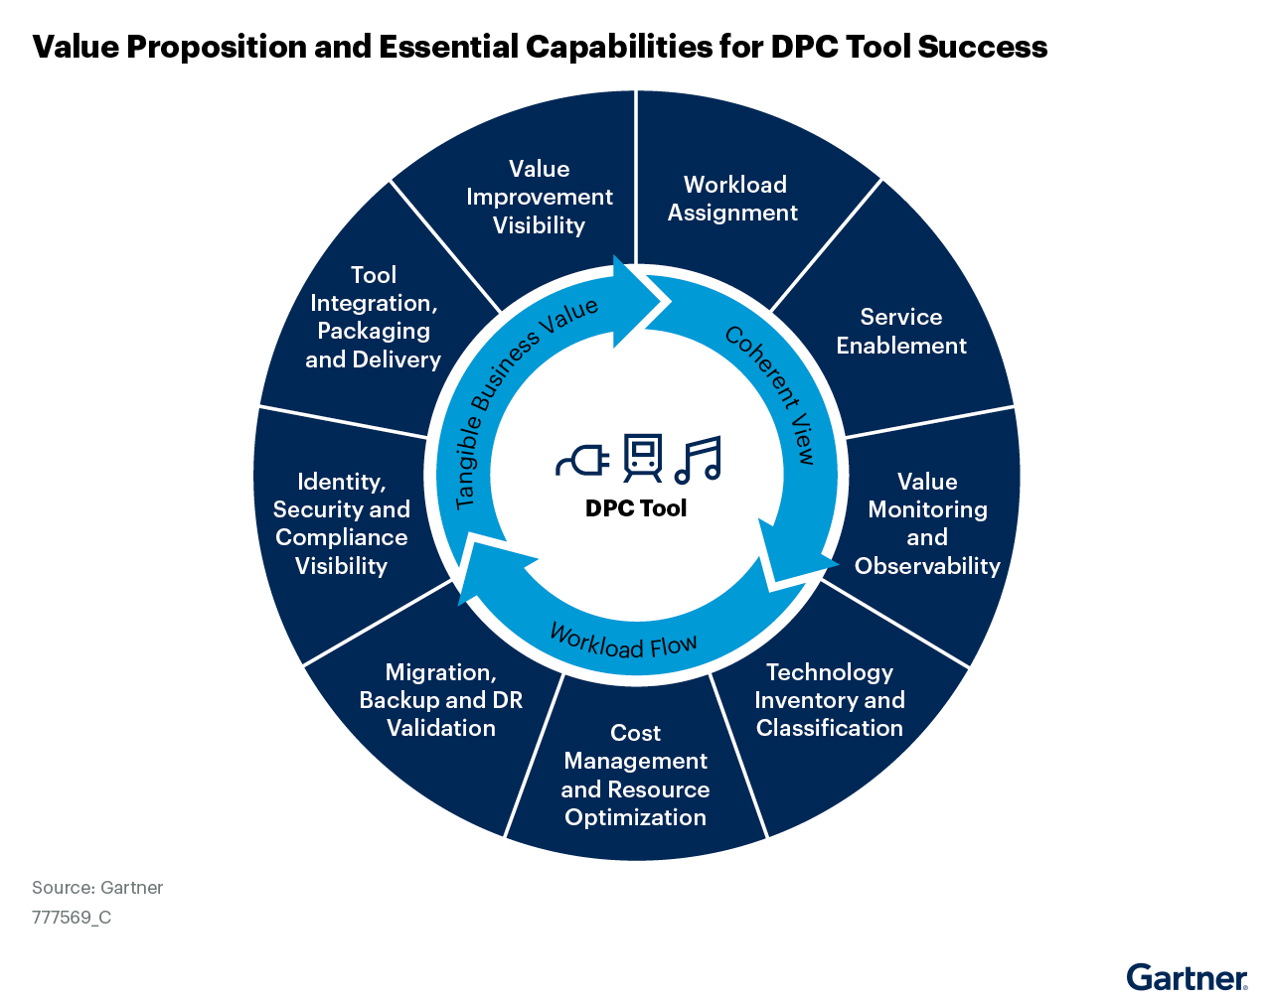
Figure 1: Value Proposition and Essential Capabilities for DPC Tool Success
Shareable Summary
View Document
4

Slide 6
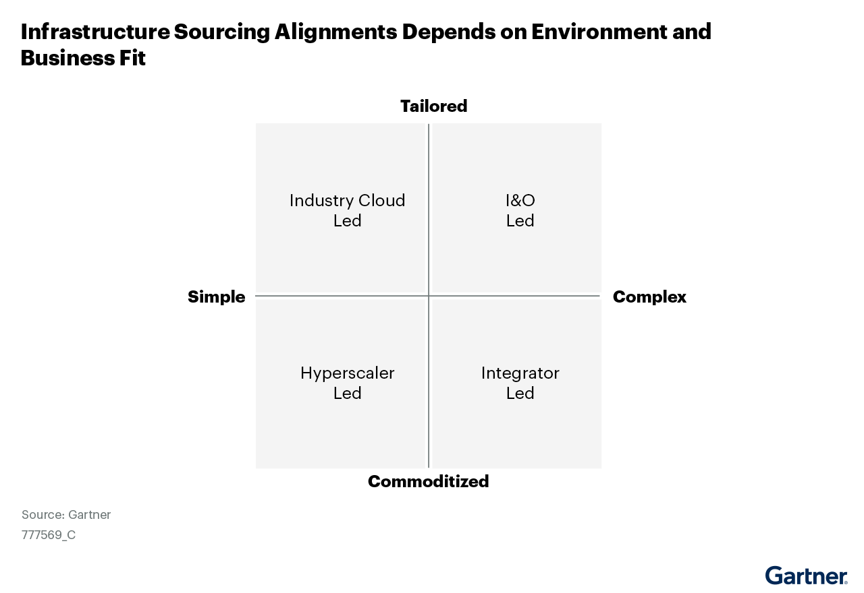
Figure 2: Infrastructure Sourcing Alignments Depend on Environment and Business Fit
Shareable Summary
View Document
5

Slide 7
Recommended by the Authors
Shareable Summary
Gartner membership required to access the research below.
To Maximize the Value of Data Centers, Combine DCIM Tools With Other Sources
3 Steps to Improve the Reliability of Large, Complex and Distributed IT Systems by Leveraging SRE Principles
Top Trends Impacting I&O for 2022: A Gartner Trend Insight Report
Market Guide for Cloud Management Tooling
View Document
6

